Slide 1


AUTOMATIC POSTAGE PAYMENT ( APP )
Presented By:
Divyanshu Kumar
BTECH/10159/21
(Software Developer Intern, Broadridge Bengaluru)
Name of the Industry Mentor : Mohit Rastogi
Name of the Institute Mentor : Dr. Aminul Islam
Department of ECE, BIT, Mesra, Ranchi-835215

Slide 2


ABOUT THE COMPANY
Broadridge
Securities Processing
Data and Analytics
Broadridge is a global fintech leader that provides investor communications and technology-driven solutions for wealth management, asset management and capital markets firms.
Investor Communication Solutions
Customer Communication
Digital Solutions

Slide 3
OUTLINE
Introduction
Motivation
Tech Stacks
Methodology
Results & Discussion
Future Work
Conclusion

Slide 4
INTRODUCTION
There are various business units in Broadridge. I am in BRCC(Broadridge Customer Communications) business unit.
BRCC is part of ICS – Broadridge Investor Communications Solutions. Broadridge Investor Communication Solutions, Inc. provides investor communication services.
The Company offers proxy mailing, vote processing, shareowner communication, meeting, disclosure, prospectus, analytics, and financial communication solutions.
APP which stands for Automatic Payment Postage, is a web application automates the payment process for postage, which means that every time we send a mail piece or package, the cost of postage is automatically deducted from a pre-funded account or charged to a selected payment method. This eliminates the need for manual transaction processing each time.

Slide 5
MOTIVATION
APP is a web application which is built on Ecomcore , which is custom framework(internal to broadridge)
Ecomcore framework is built on JAVA.
So in this project out team need to build the whole web application over Angular and Spring Boot framework.
Here Angular for building frontend and Spring Boot for building Backend will be used.

Slide 6

TECH STACKS
Spring Boot:
Spring Boot is an open-source Java framework designed to simplify
the creation and deployment of Java applications.
It helps in Rapid Application Development.
Model-View-Controller (MVC) Architecture: Spring Boot follows the widely used MVC architecture pattern, where the application is divided into three main components: Model, View, and Controller. This helps to separate the concerns of the application and promotes the modularity and reusability of the code.
Dependency Injection: Spring Boot uses dependency injection to manage the dependencies between different components of the application. This allows for loose coupling between components and makes the code more maintainable and testable.

Slide 7
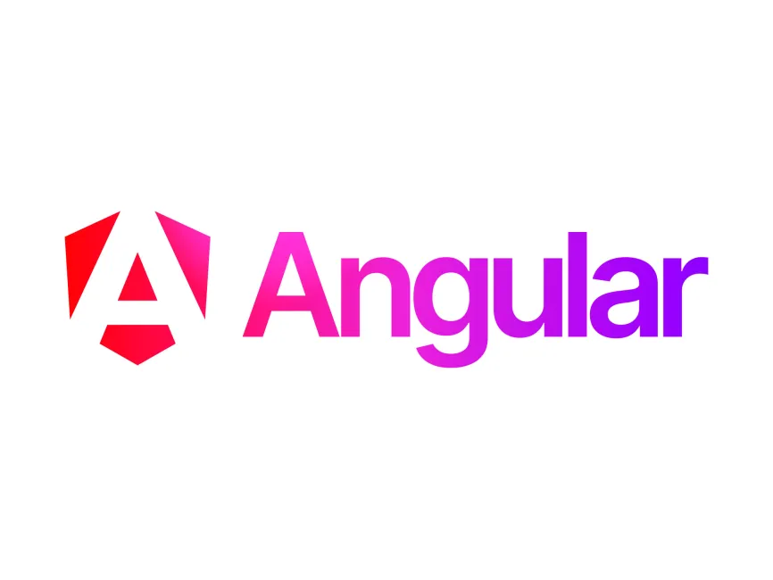
TECH STACKS
Angular:
Angular is a platform and framework for building single-page client
applications using HTML and TypeScript. Developed and maintained
by Google, it is a comprehensive framework for building modern web
applications.
Angular’s component-based structure allows for modular development. This means that each component encapsulates its own functionality and can be reused across different parts of an application, promoting better code organization and easier maintenance.
Angular’s two-way data binding automatically synchronizes data between the model and the view. This reduces boilerplate code and allows for more efficient and responsive user interfaces, as changes in the application state are automatically reflected in the UI.

Slide 8
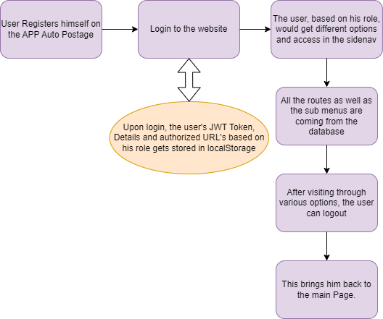
METHODOLOGY
1st Task: (FRONTEND)
Creating an angular Project
Creating and designing Components:
Login & Register Page
Toggling Side-nav & Navbar
Dashboard
Making use of Local Storage for various purposes.
Handling Routes & Sub Menus from the Backend based on User Role.
Using various directives in order to bind and maintain the flow of data.

Slide 9
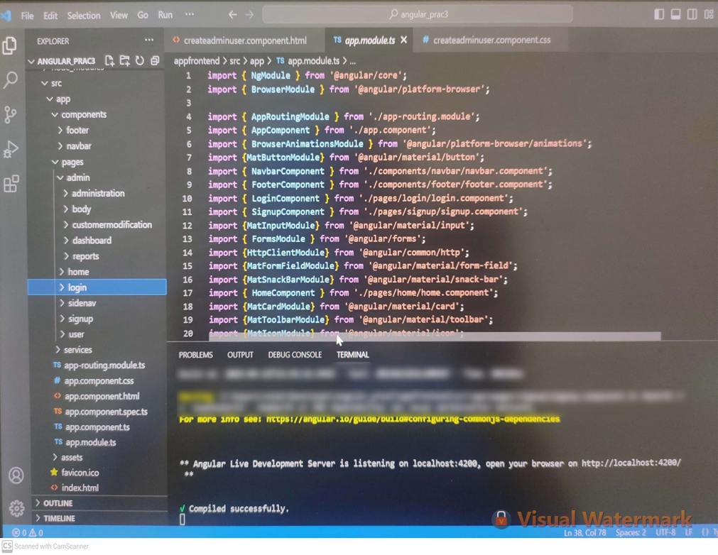
METHODOLOGY
Code SnapShot for frontend:

Slide 10
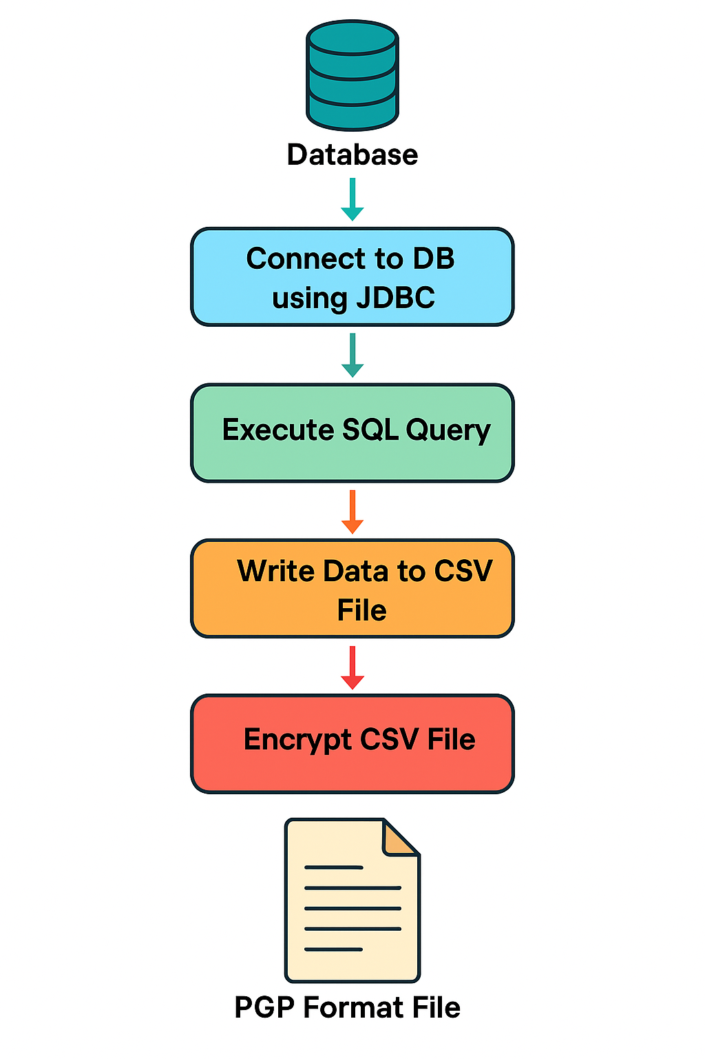
METHODOLOGY
2nd Task:
I was provided with a MySQL Database through which I
needed to migrate data into a CSV File.`
After the migration, I needed to encrypt the CSV file
using PGP Encryption(by means of PUBLIC & PRIVATE
keys) and store it in a PGP File.

Slide 11
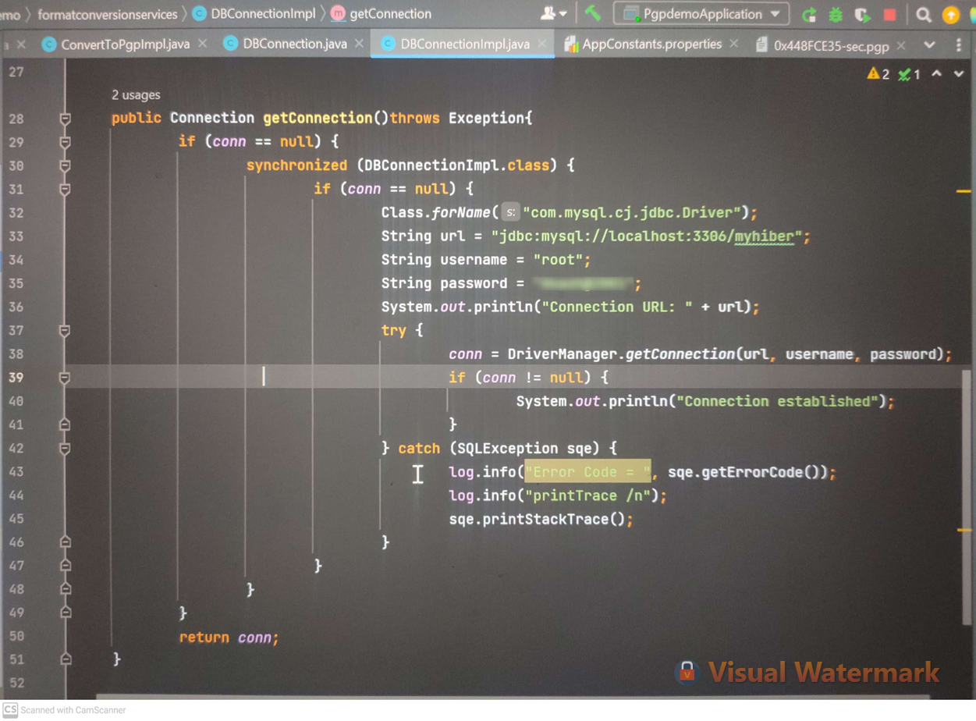
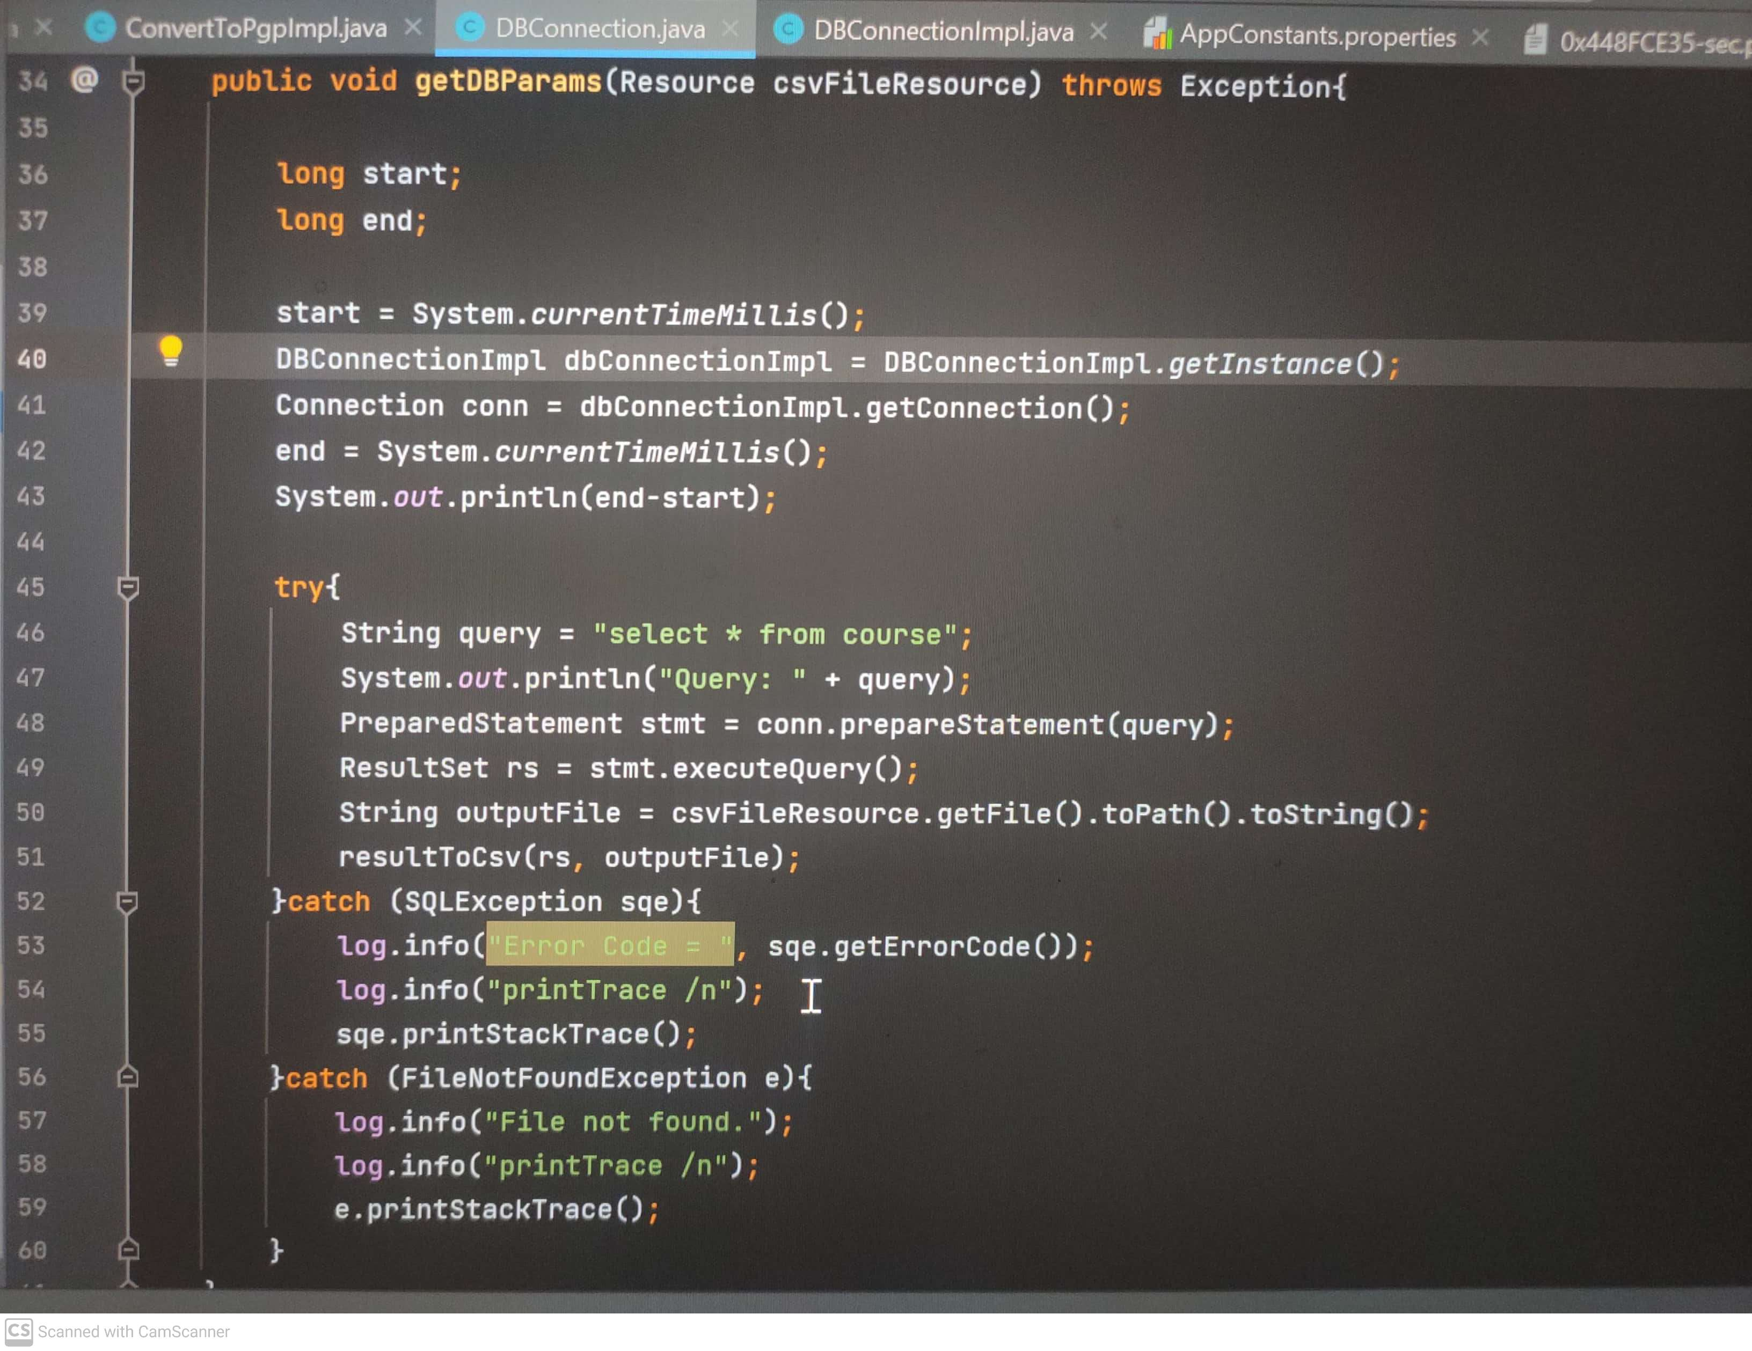
METHODOLOGY
DB connection & Query execution codes:

Slide 12
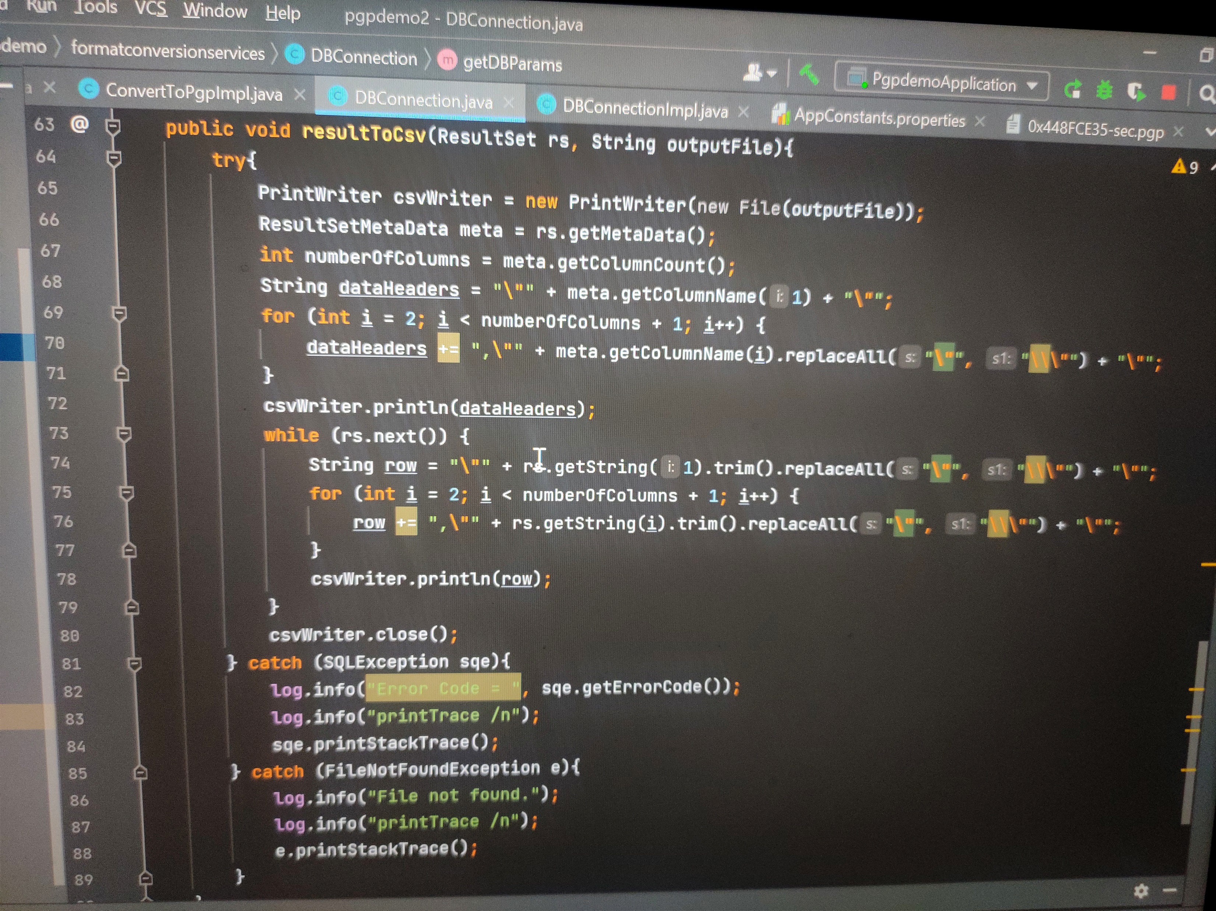
METHODOLOGY
Writing to CSV file code :

Slide 13
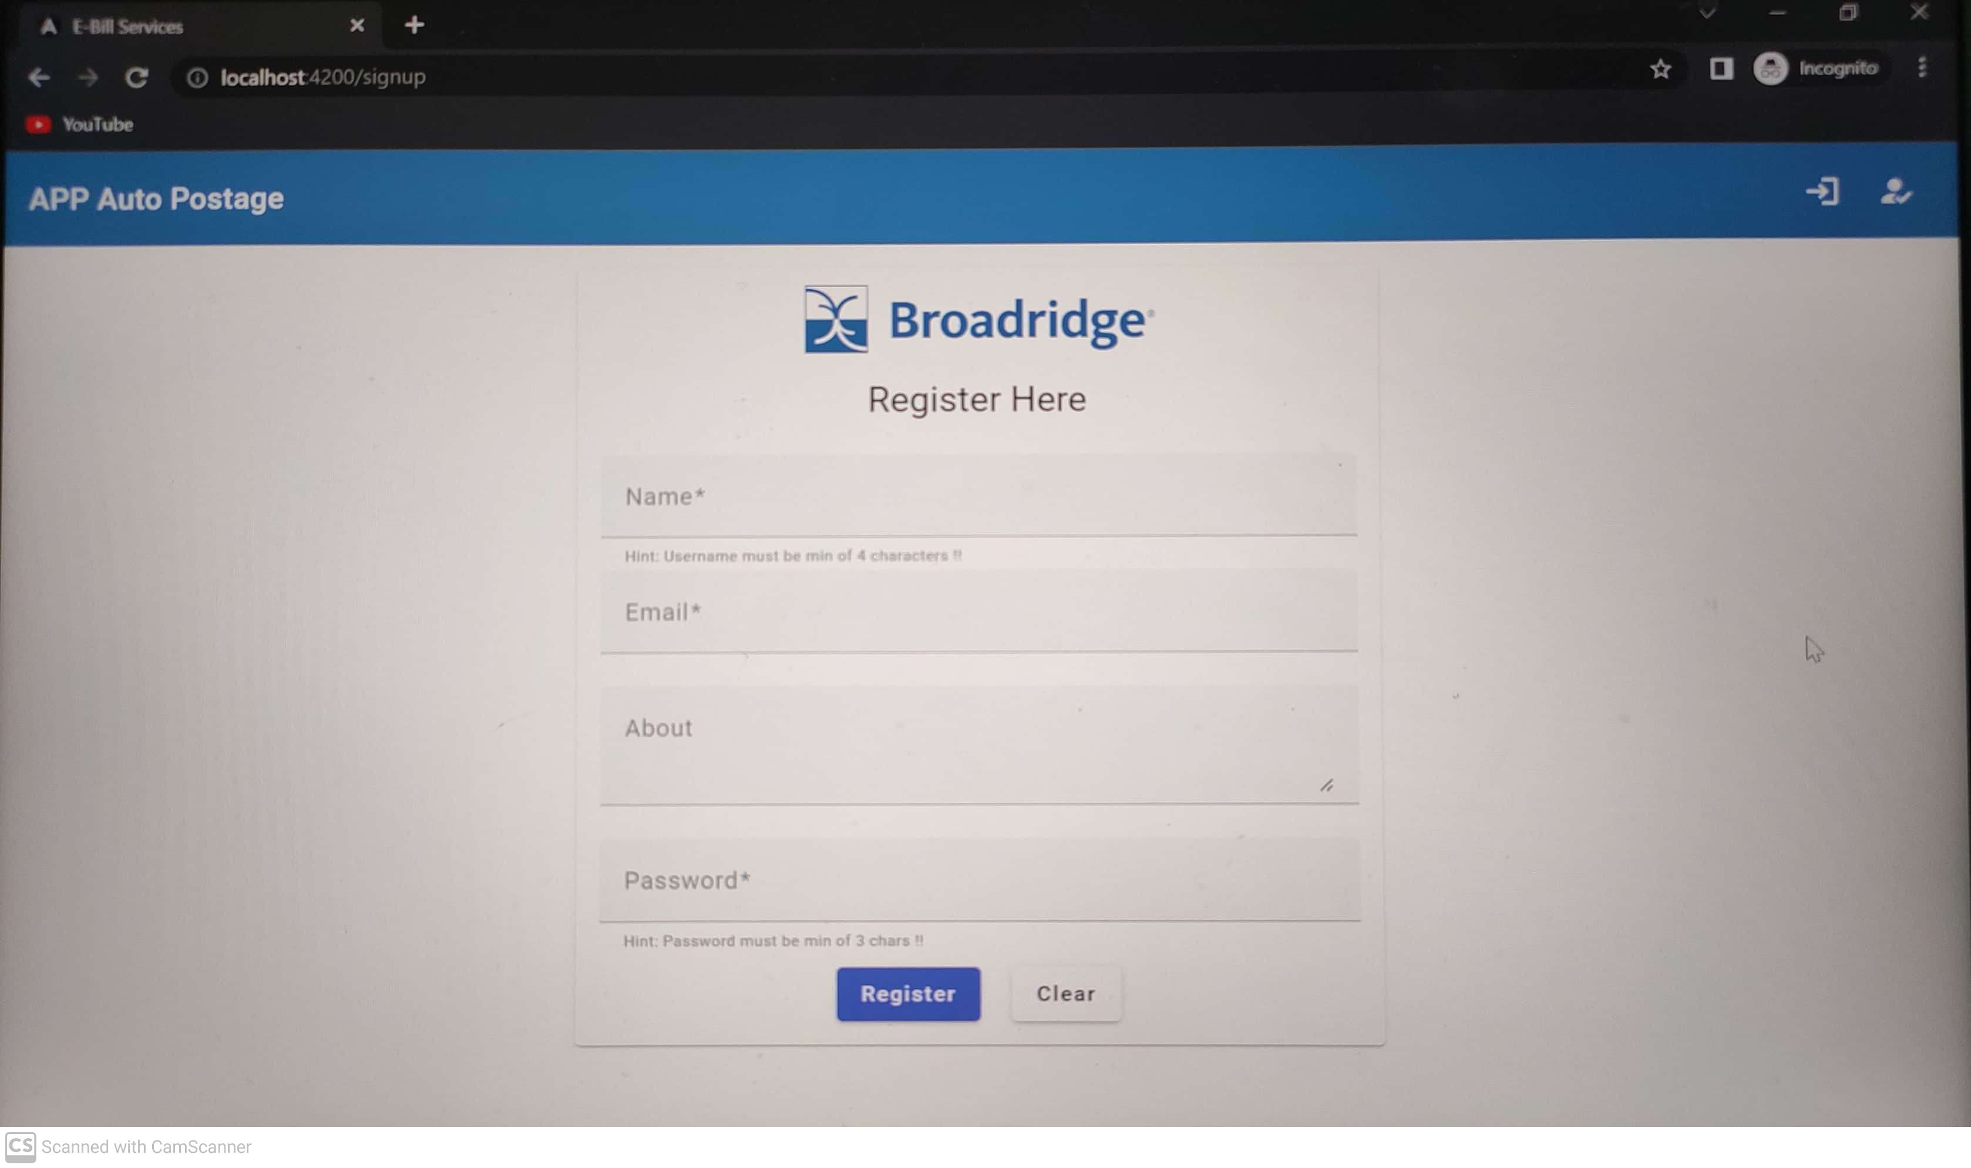
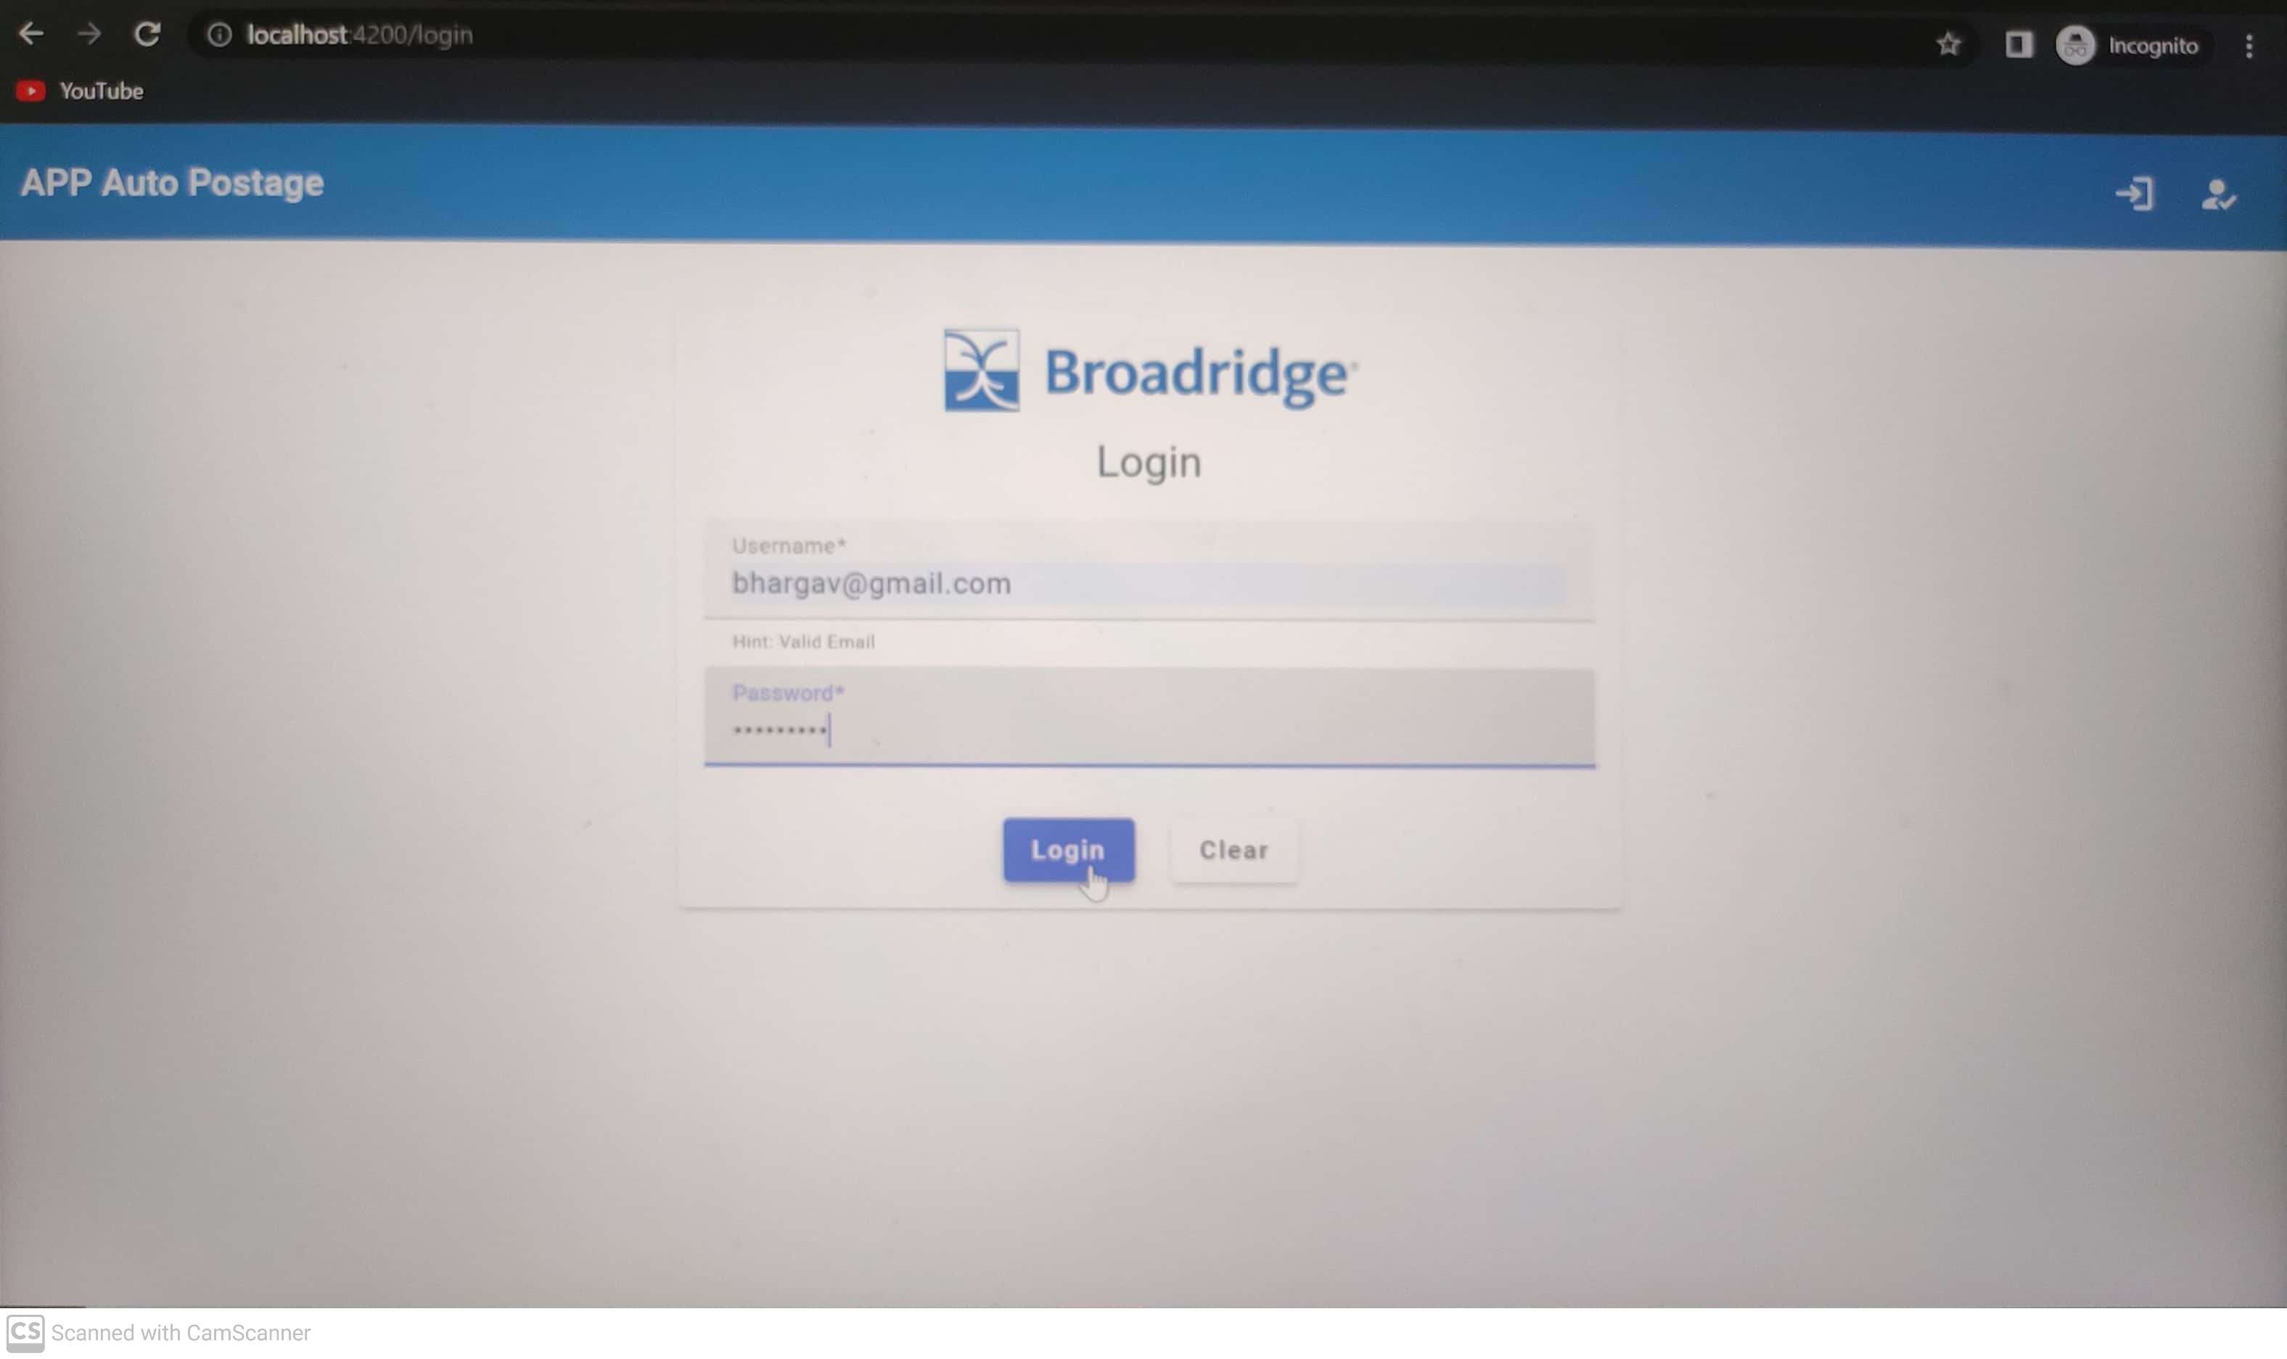
RESULTS & DISCUSSION :
Task 1 results :

Slide 14
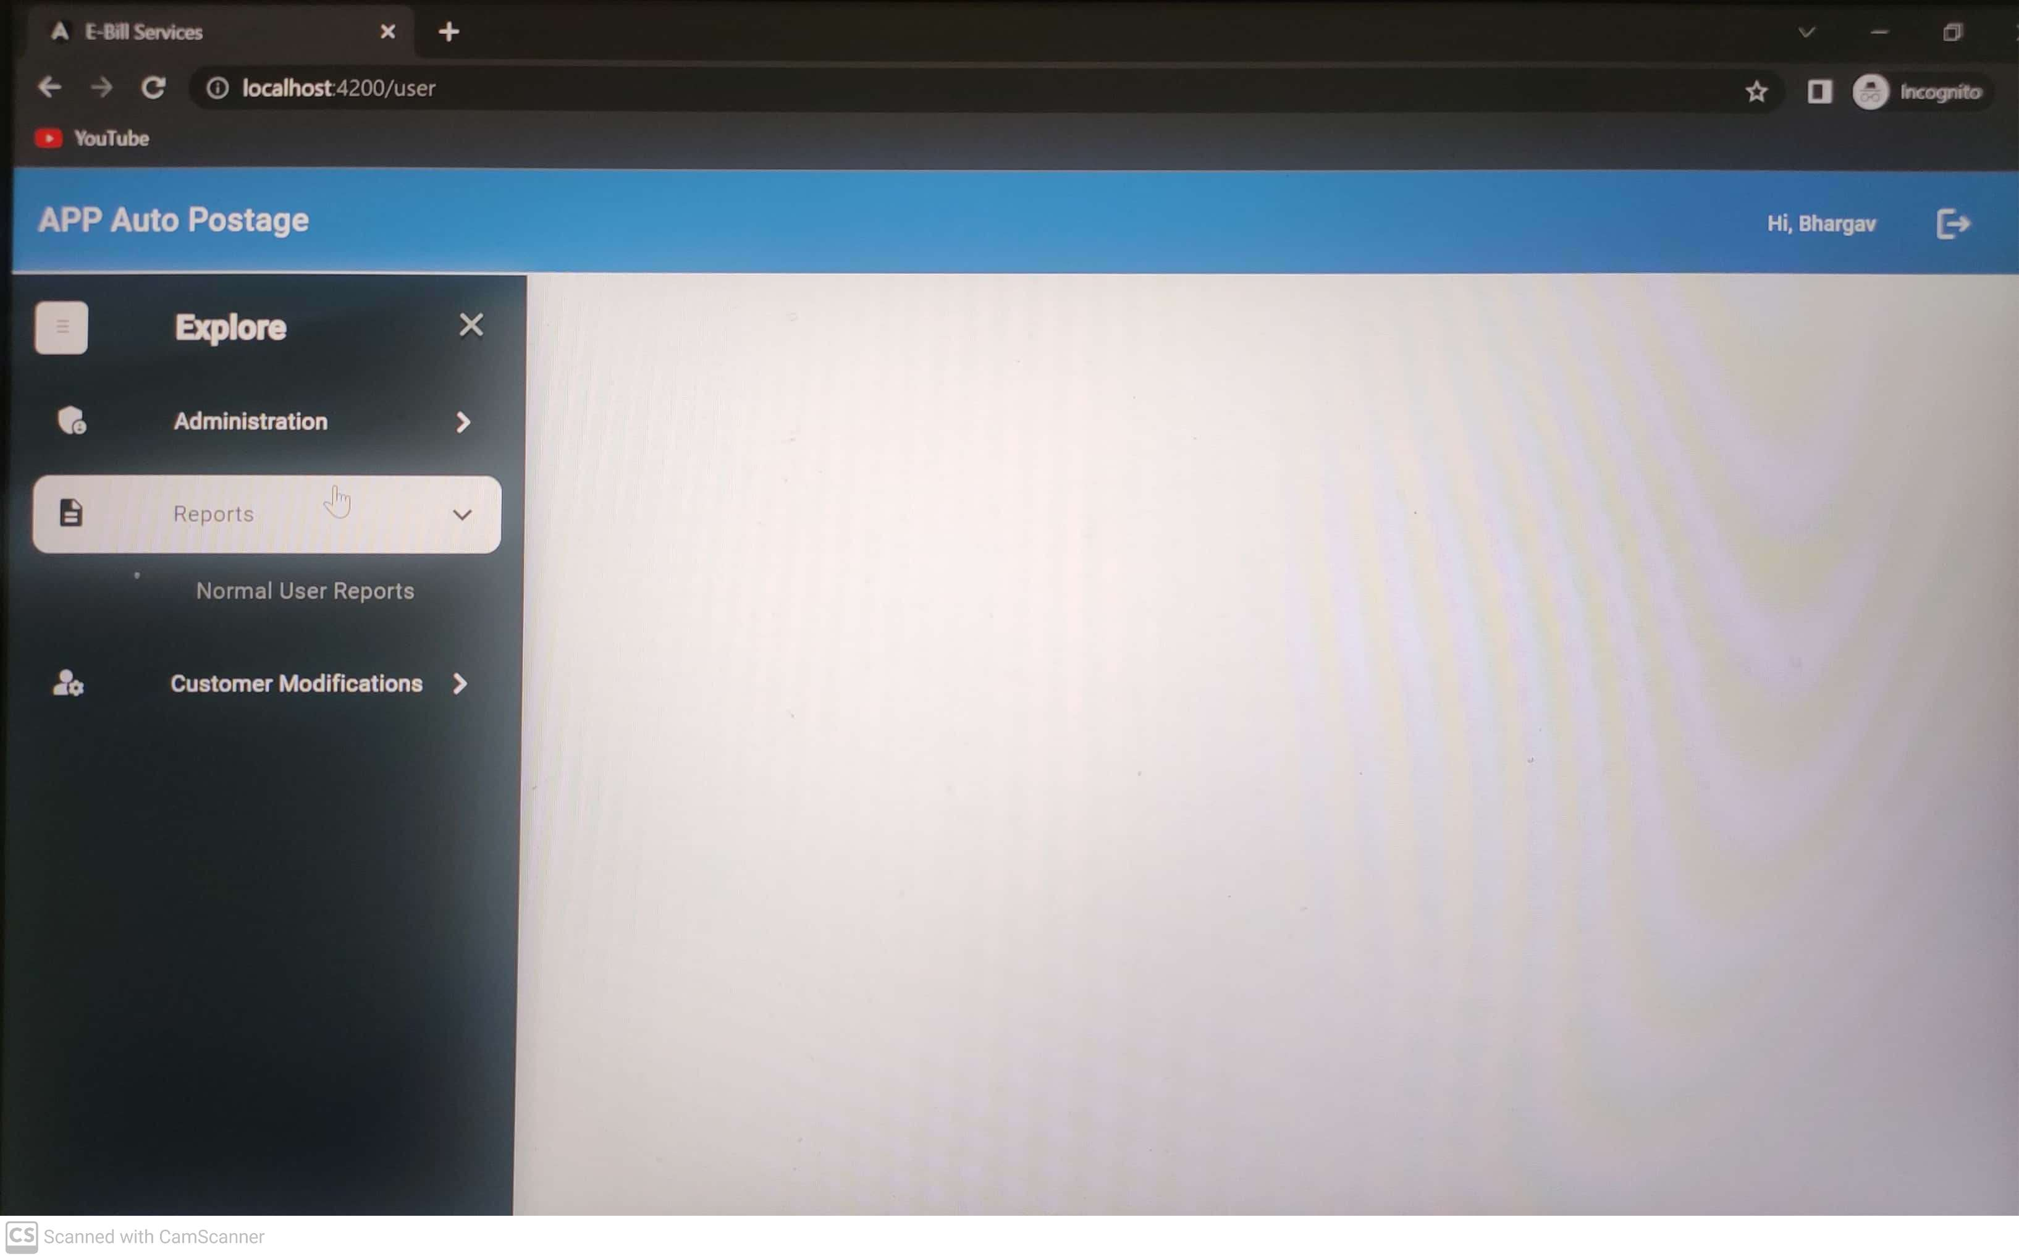
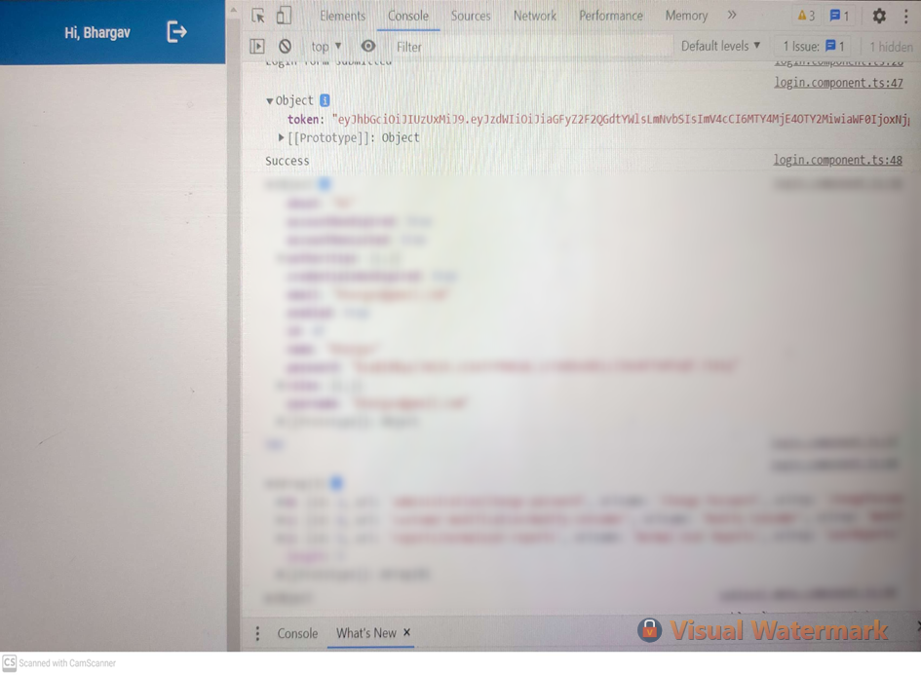
RESULTS & DISCUSSION :

Slide 15
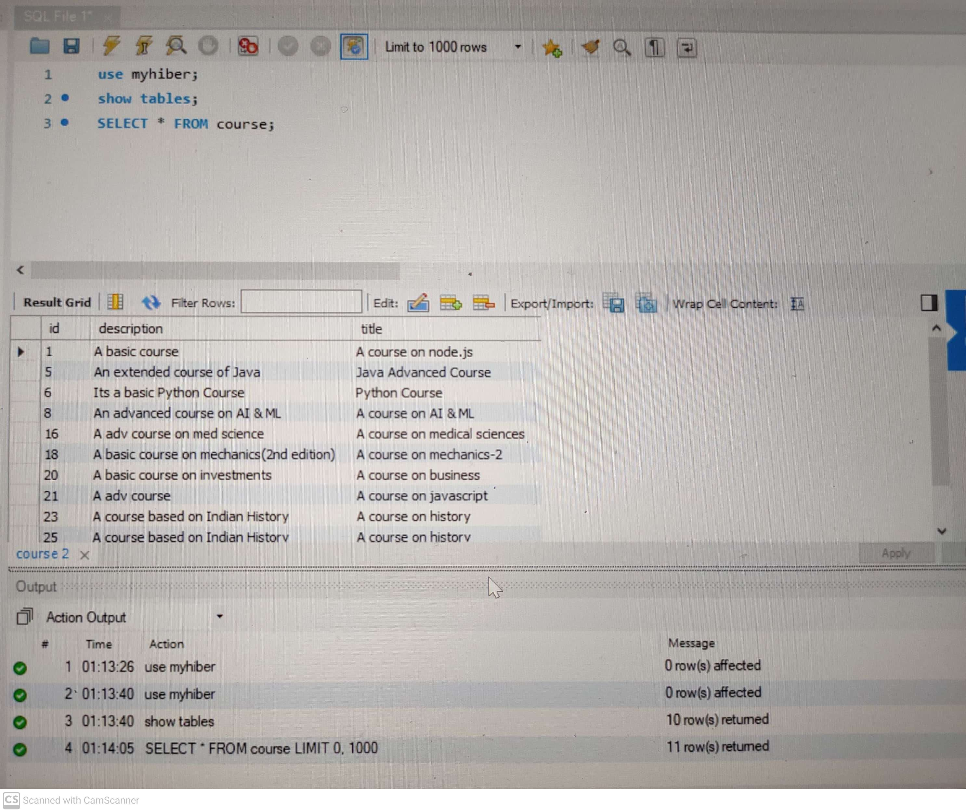
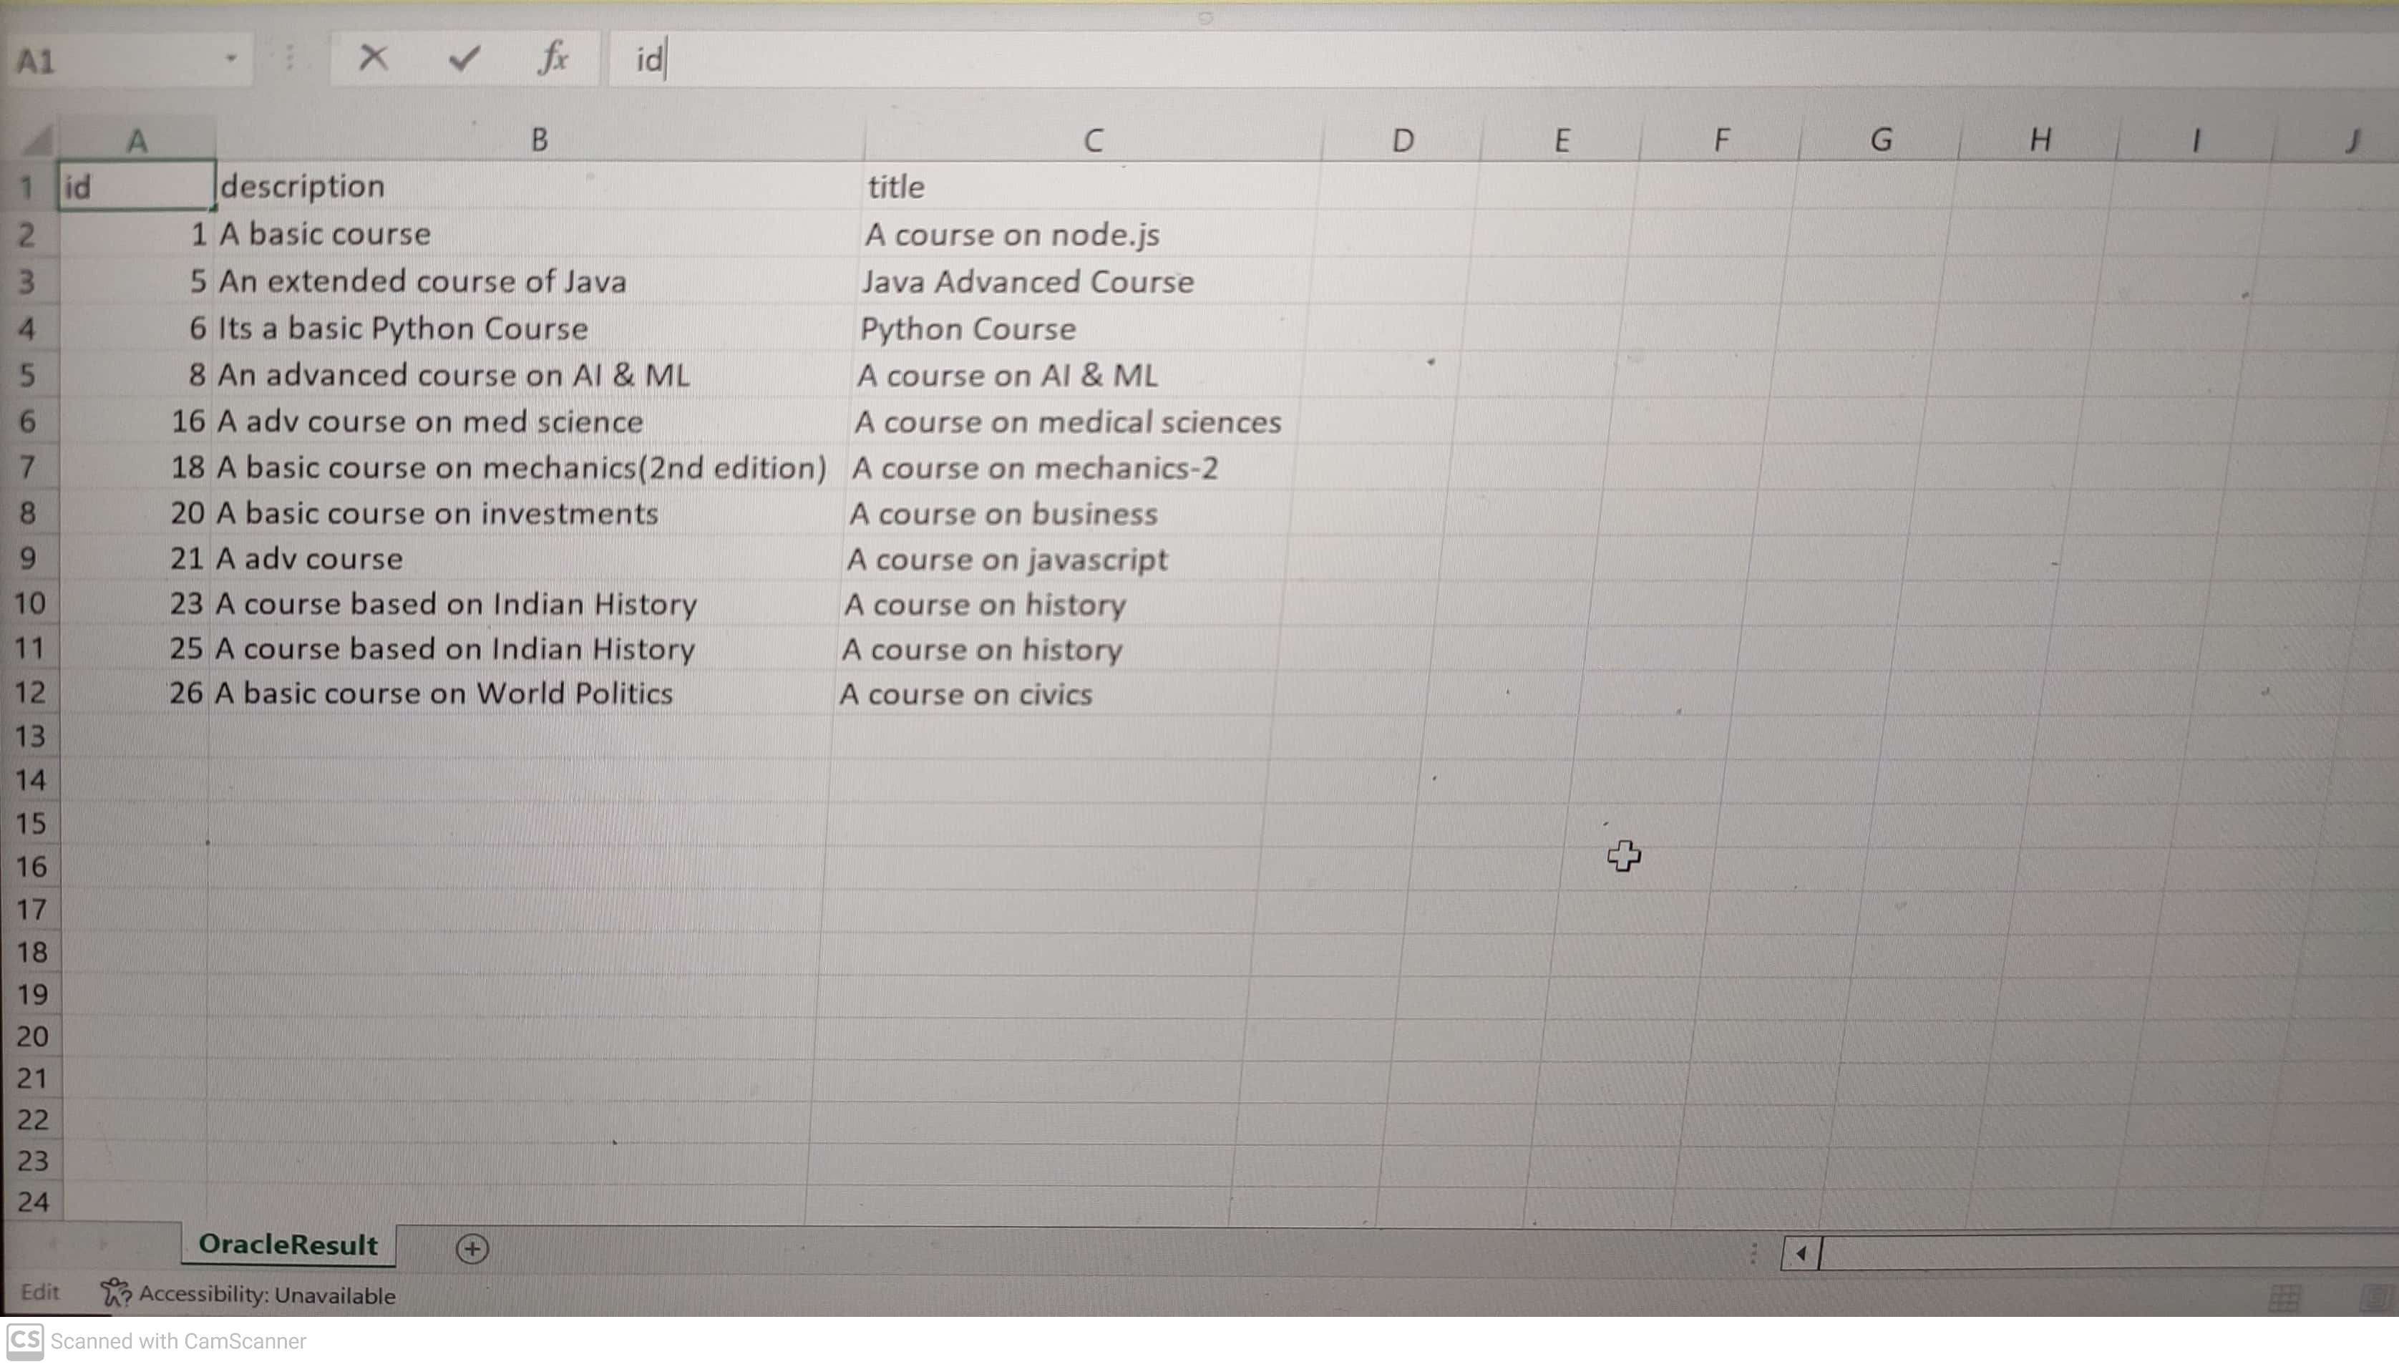
RESULTS & DISCUSSION :
Task 2 results :

Slide 16
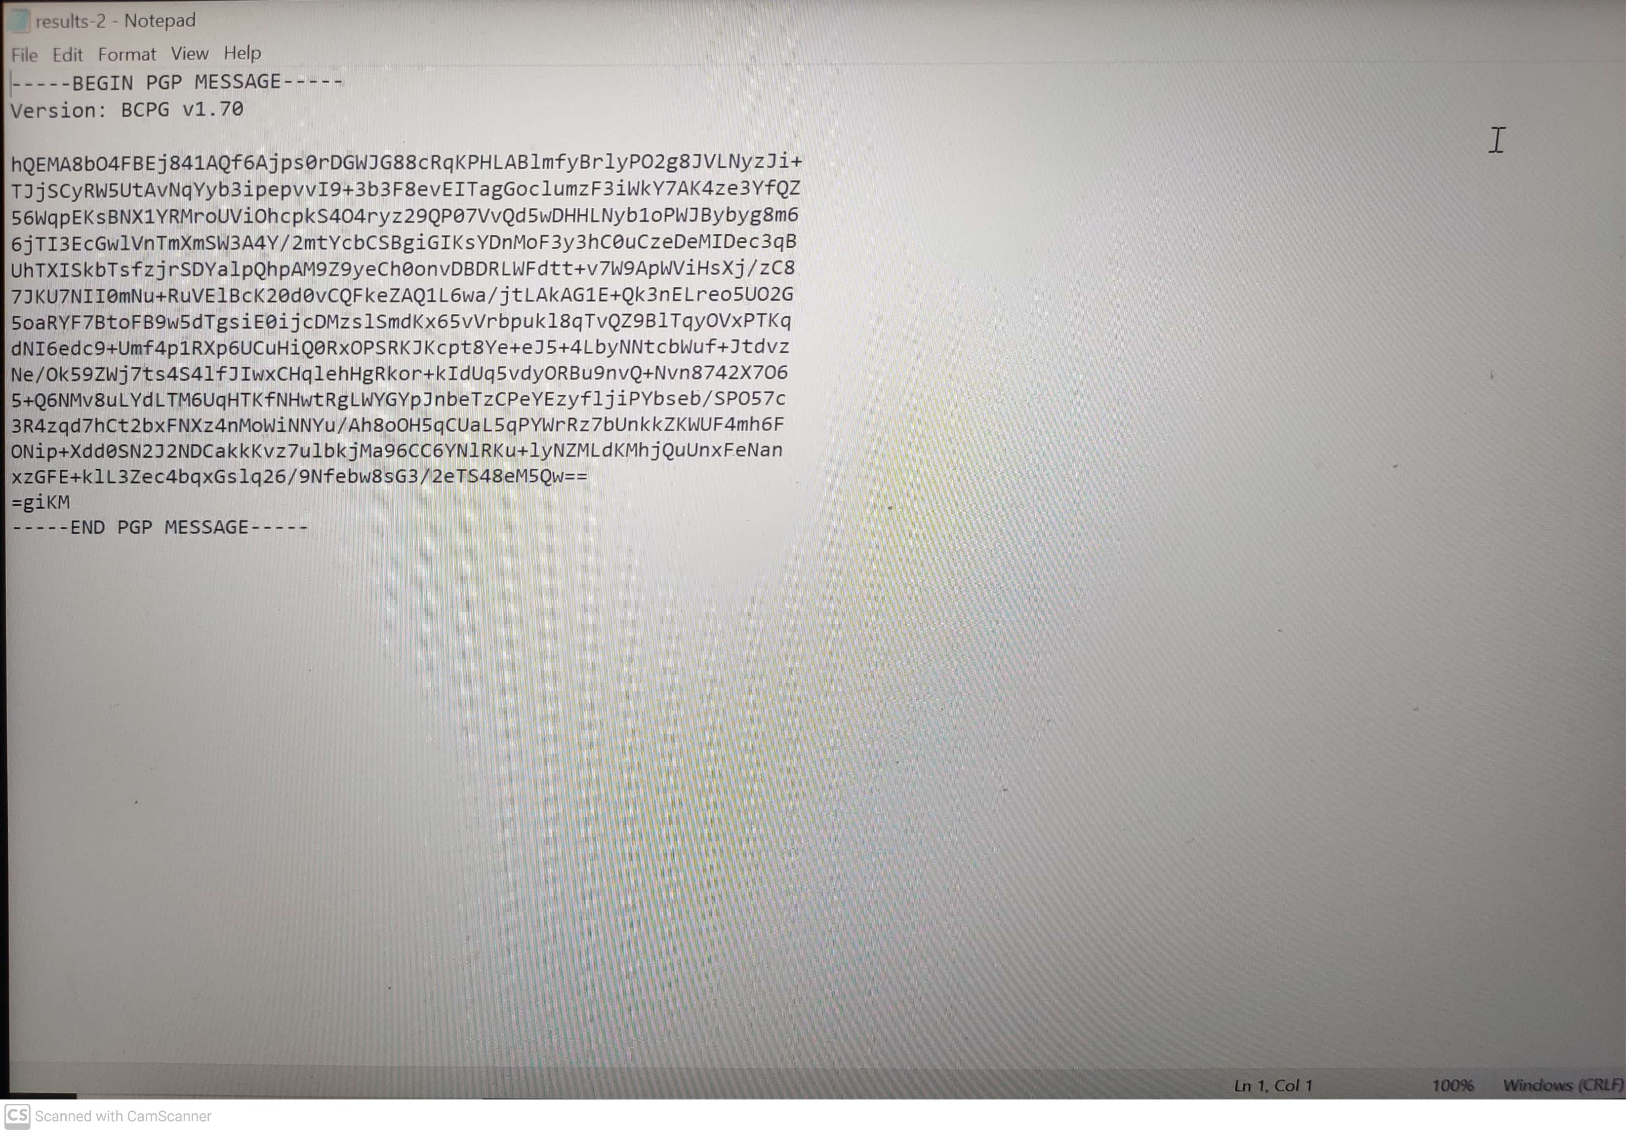
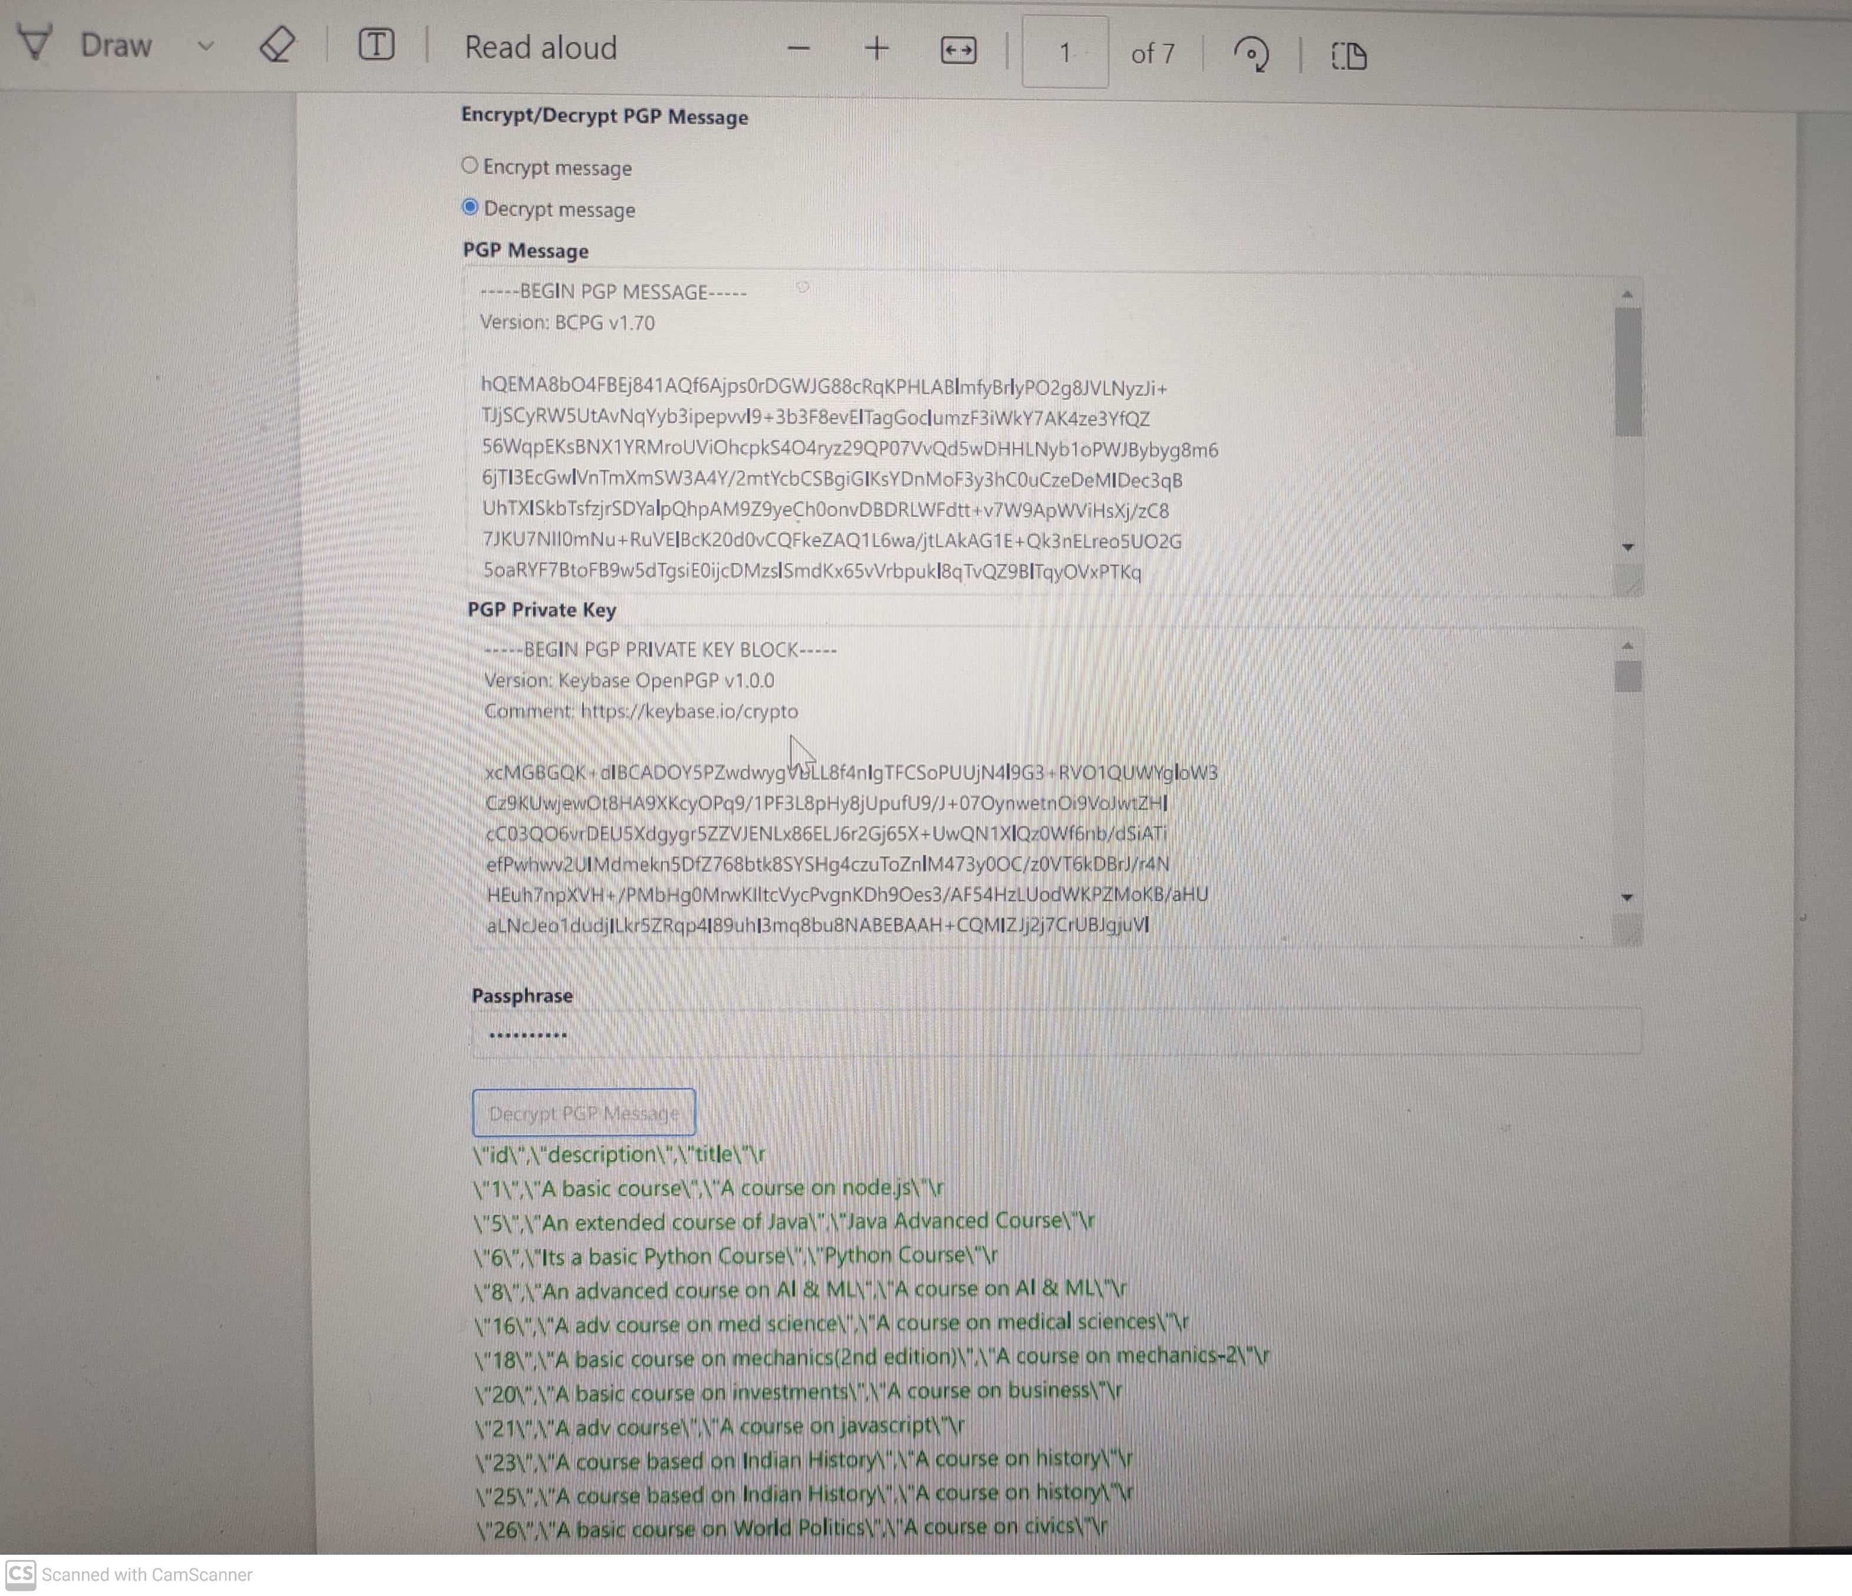
RESULTS & DISCUSSION :

Slide 17
FUTURE WORK
The frontend of the application is currently under development.
Records are being migrated on a daily basis to the Database.
After this the team will start writing api’s in the backend so that the client can also see his annual reports.
API’s will also be written in backend to take care of various services.
To ensure secure transaction handling, it is being discussed to use Spring Security with JWT authentication over HTTPS to protect data in transit and restrict access.
After this the application will be pushed to the main branch repository and will be under Quality Assurance to undergo the testing process.

Slide 18
CONCLUSION
The transformation of the APP web application from the Ecomcore framework to a modern architecture using Spring Boot and Angular not only updates the technological foundation of the application but also enhances its scalability, maintainability, and user experience.
Throughout the process, leveraging Angular for the front-end will allow us to create a responsive and dynamic user interface, while Spring Boot on the back-end will provide a robust environment for developing scalable and efficient application logic.

Slide 19
THANK YOU

